Slide 1
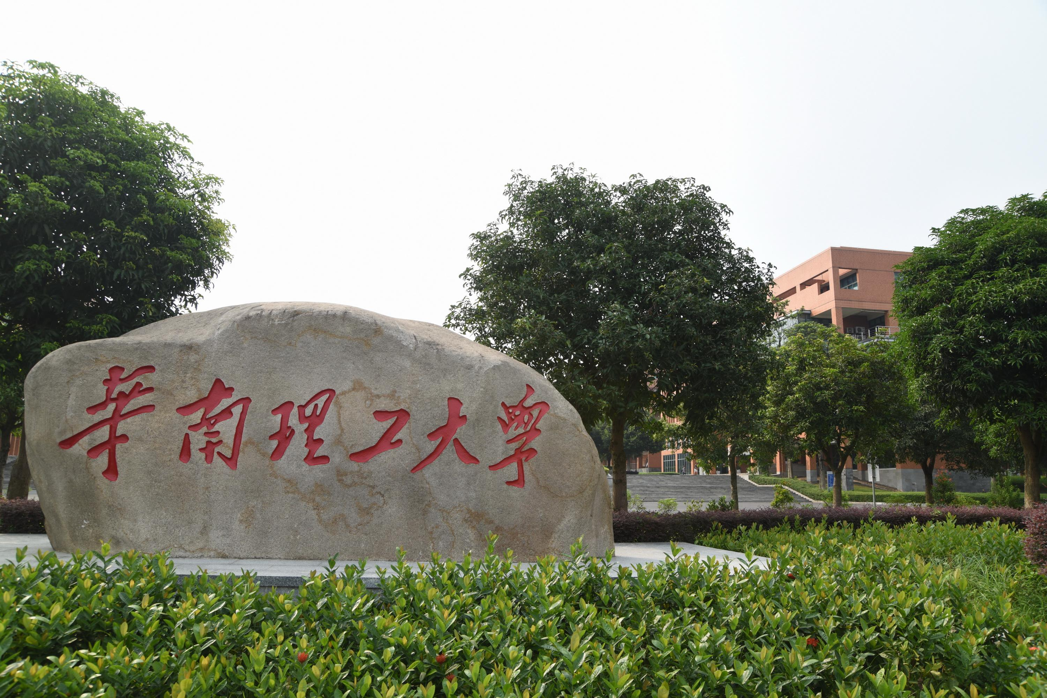



SOUTH CHINA UNIVERSITY OF TECHNOLOGY
Project presentation
24th Aug, 2022
Reporter：Jieyi Sun (group leader), Yuxuan Chen, Ruoqi Chen, Yihao Shen, Weiyue Zhang, Yongjie Liang
Professor：Pietro Liò

Slide 2
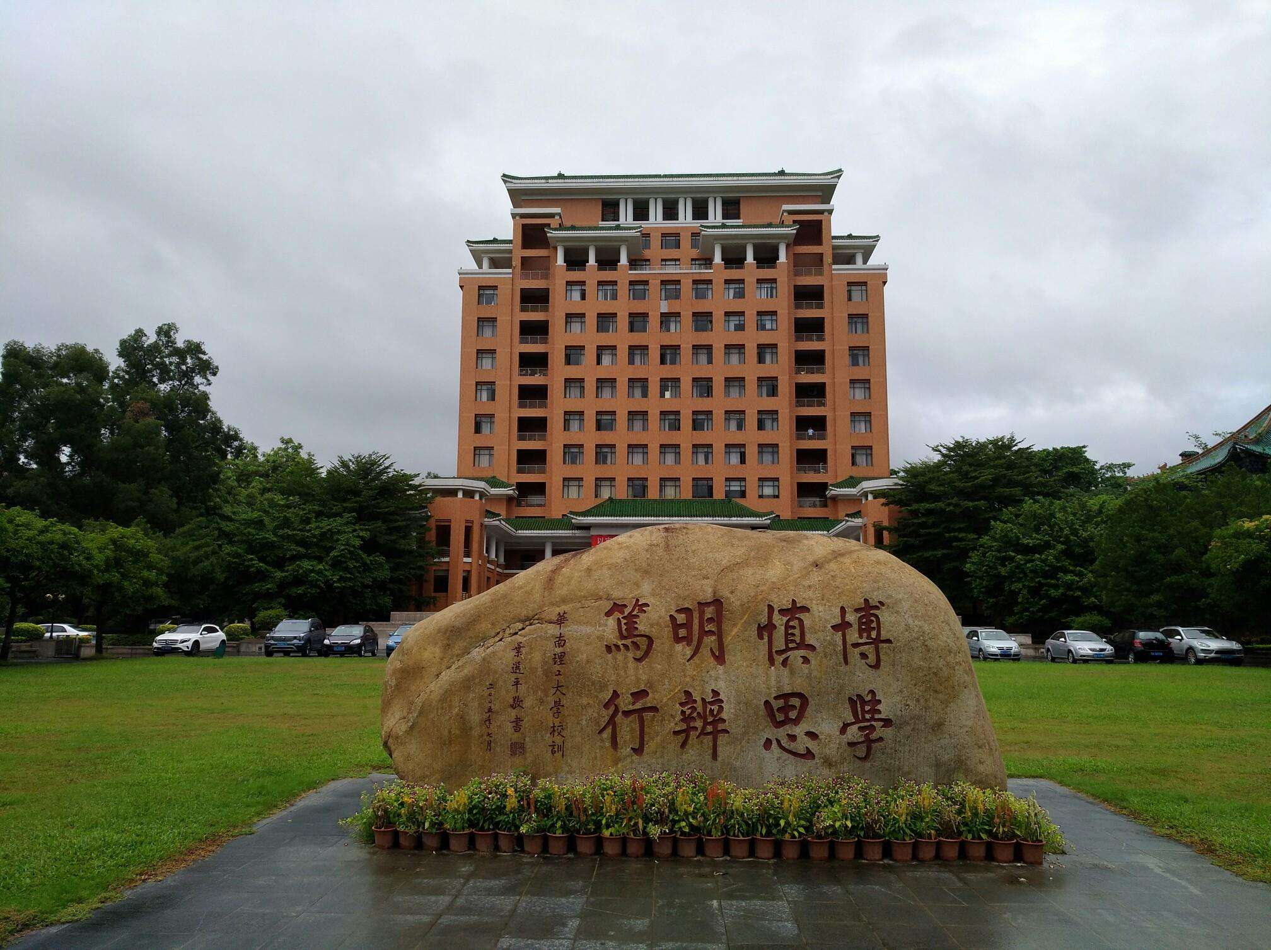



SOUTH CHINA UNIVERSITY OF TECHNOLOGY
目 录
01
Background
CONTENTS
02
Methodology
03
Result
04
Conclusion

Slide 3
SOUTH CHINA UNIVERSITY OF TECHNOLOGY
01
Background

Slide 4


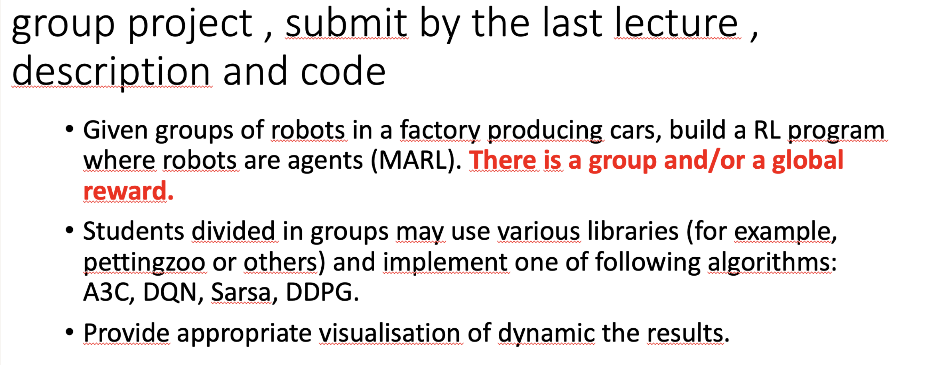

Introduction of our project
SOUTH CHINA UNIVERSITY OF TECHNOLOGY
请输入您的标题

Slide 5
SOUTH CHINA UNIVERSITY OF TECHNOLOGY
02
Methodology

Slide 6
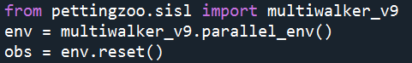
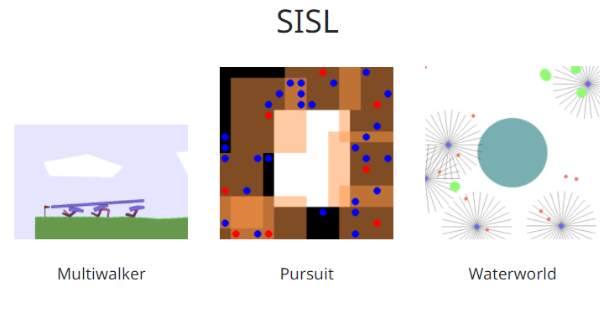
Library： PettingZoo
SOUTH CHINA UNIVERSITY OF TECHNOLOGY
PettingZoo is a Python library for conducting research in multi-agent reinforcement learning, akin to a multi-agent version of Gym.
The SISL environments are a set of three cooperative multi-agent benchmark environments, created at SISL (Stanford Intelligent Systems Laboratory)) and released as part of “Cooperative multi-agent control using deep reinforcement learning.”
Reference
https://github.com/Farama-Foundation/PettingZoo
https://www.pettingzoo.ml/sisl

Slide 7
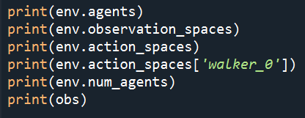
Game: multiwalker_v9
SOUTH CHINA UNIVERSITY OF TECHNOLOGY
Output:
['walker_0', 'walker_1', 'walker_2']
{'walker_0': Box(-inf, inf, (31,), float32), 'walker_1': Box(-inf, inf, (31,), float32), 'walker_2': Box(-inf, inf, (31,), float32)}
{'walker_0': Box(-1.0, 1.0, (4,), float32), 'walker_1': Box(-1.0, 1.0, (4,), float32), 'walker_2': Box(-1.0, 1.0, (4,), float32)}
Box(-1.0, 1.0, (4,), float32)
3

Slide 8
Game: multiwalker_v9
SOUTH CHINA UNIVERSITY OF TECHNOLOGY
{'walker_0': array([ 0.0000000e+00, 0.0000000e+00, 0.0000000e+00, 0.0000000e+00,
0.0000000e+00, 0.0000000e+00, 1.0000000e+00, 0.0000000e+00,
0.0000000e+00, 0.0000000e+00, 0.0000000e+00, 1.0000000e+00,
0.0000000e+00, 0.0000000e+00, 1.6236708e-01, 1.6546237e-01,
4.4486943e-01, 4.7198775e-01, 5.1494205e-01, 5.8084798e-01,
6.8370843e-01, 8.5414934e-01, 9.1396463e-01, 8.7226135e-01,
0.0000000e+00, 0.0000000e+00, 3.3982340e-01, -1.0630253e-03,
3.4002113e-01, 8.2342118e-02, -7.6692115e-04], dtype=float32), 'walker_1': array([ 0.0000000e+00, 0.0000000e+00, 0.0000000e+00, 0.0000000e+00,
0.0000000e+00, 0.0000000e+00, 1.0000000e+00, 0.0000000e+00,
0.0000000e+00, 0.0000000e+00, 0.0000000e+00, 1.0000000e+00,
0.0000000e+00, 0.0000000e+00, 1.6236708e-01, 1.6546237e-01,
4.4028637e-01, 4.6928895e-01, 5.1376164e-01, 5.8566523e-01,
6.9834220e-01, 9.0874815e-01, 9.1396481e-01, 8.7226135e-01,
-3.4149846e-01, 8.1503624e-04, 3.4172782e-01, 7.4598670e-04,
1.0107465e-05, 8.3283454e-02, 7.1430003e-04], dtype=float32), 'walker_2': array([ 0. , 0. , 0. , 0. , 0. ,
0. , 1. , 0. , 0. , 0. ,
0. , 1. , 0. , 0. , 0.16236708,
0.16546237, 0.4690788 , 0.49562368, 0.53648156, 0.60175025,
0.6974481 , 0.86567634, 1. , 1. , -0.33996174,
0.00110376, 0. , 0. , -0.3400785 , 0.08287704,
0.00193377], dtype=float32)}

Slide 9

Game: multiwalker_v9
SOUTH CHINA UNIVERSITY OF TECHNOLOGY
In this environment, bipedal robots attempt to carry a package as far right as possible. A package is placed on top of 3 (by default) bipedal robots which you control. A positive reward is awarded to each walker, which is proportional to the change in the package distance and is scaled by forward_reward. The maximum achievable total reward depends on the terrain length; as a reference, for a terrain length of 75 steps, the total reward under an optimal policy is around 300 . If shared_reward is chosen (True by default), all agents receive the mean reward across agents. The agents also receive a small shaped reward of -5 times the change in their head angle to keep the head straight.

Slide 10
Game: multiwalker_v9
SOUTH CHINA UNIVERSITY OF TECHNOLOGY
If a walker falls, it is penalized -10. By default, the environment is done if any walker or the package falls, or if the package goes beyond the left edge of the terrain. In all of these cases, each walker receives an additional reward of -100. If the terminate_on_fall setting is set to False, the game continues until the package falls. If the remove_on_fall setting is set to True, the walkers are removed from the environment after they fall. The environment is also done if package falls off the right edge of the terrain, with no additional reward or penalty.
Each walker exerts force on two joints in their two legs, giving a continuous action space represented as a 4 element vector. Each walker observes via a 31 element vector containing simulated noisy lidar data about the environment and information about neighboring walkers. The environment’s duration is capped at 500 frames by default (can be controlled by the max_cycles setting).

Slide 11
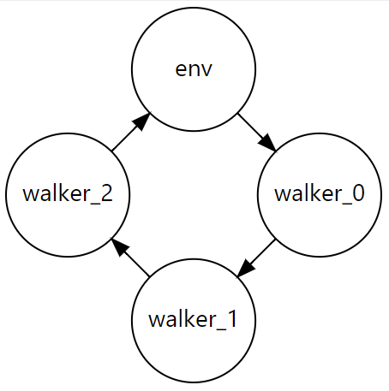
Game: multiwalker_v9
SOUTH CHINA UNIVERSITY OF TECHNOLOGY

Slide 12
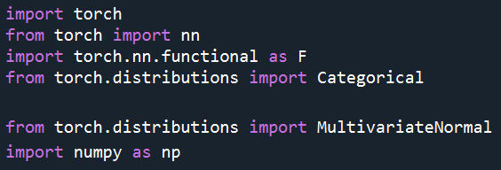
Algorithm：PPO
SOUTH CHINA UNIVERSITY OF TECHNOLOGY

Slide 13
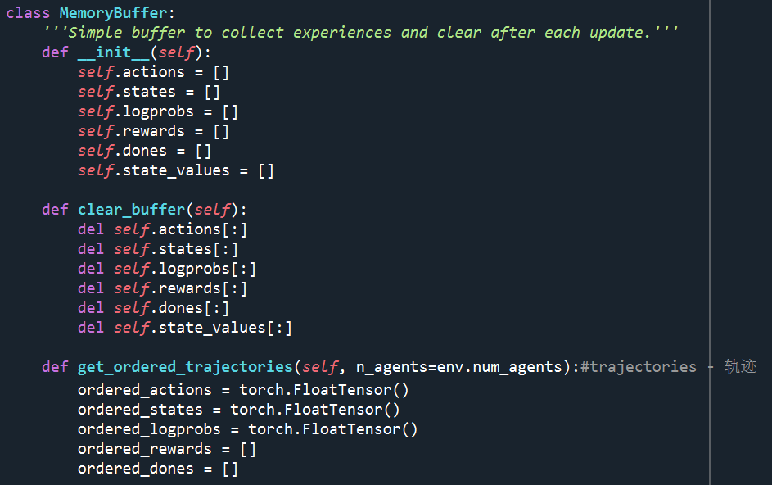
Algorithm：PPO
SOUTH CHINA UNIVERSITY OF TECHNOLOGY

Slide 14
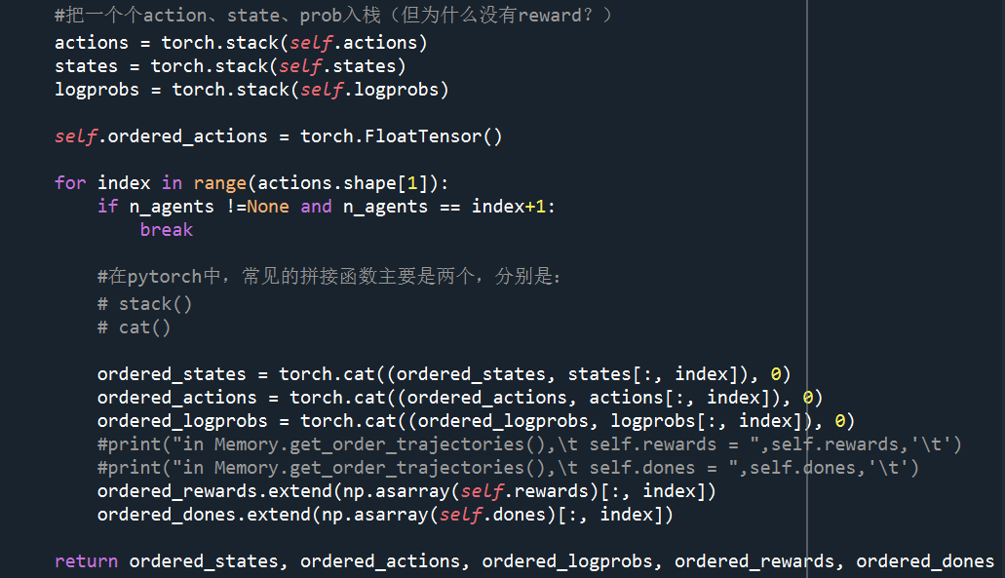
Algorithm：PPO
SOUTH CHINA UNIVERSITY OF TECHNOLOGY
Splicing function

Slide 15
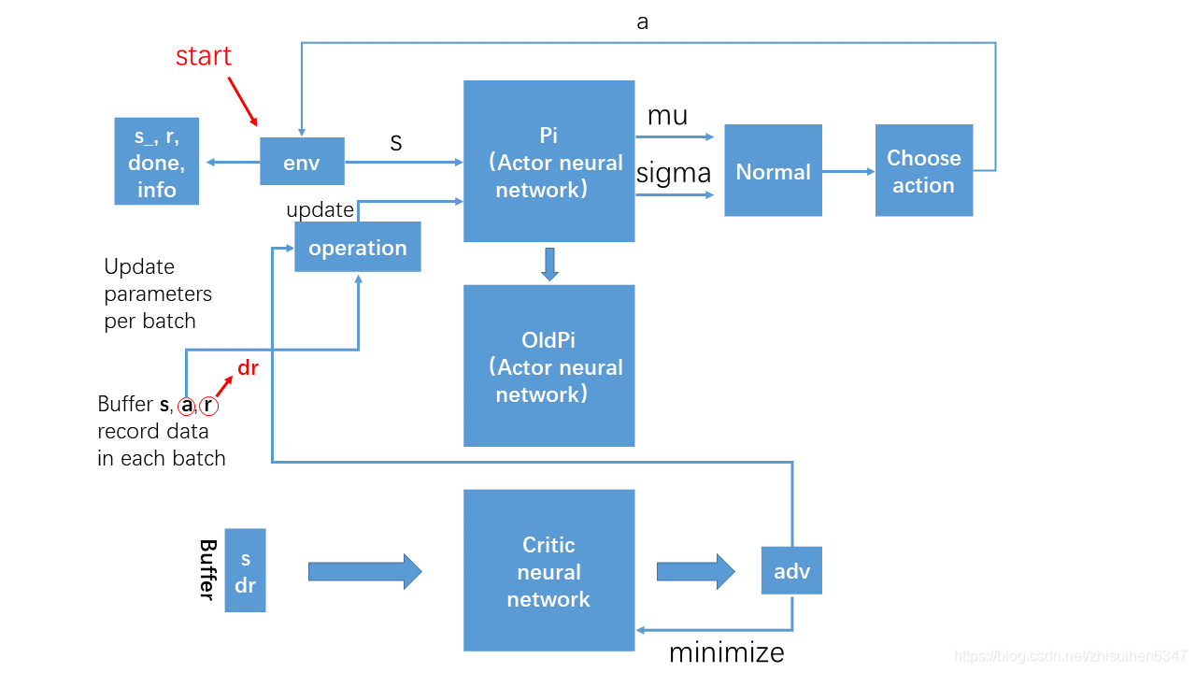
Algorithm：PPO
SOUTH CHINA UNIVERSITY OF TECHNOLOGY

Slide 16
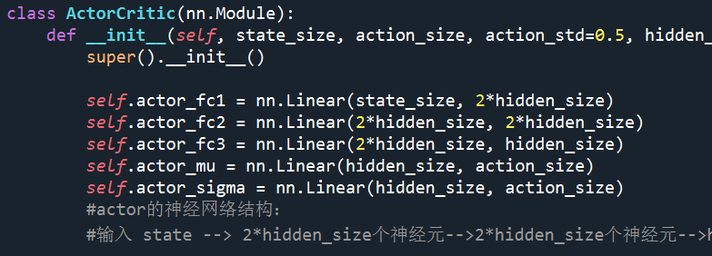
Algorithm：PPO (Actor net)
SOUTH CHINA UNIVERSITY OF TECHNOLOGY

Slide 17


Algorithm：PPO (Actor net)
SOUTH CHINA UNIVERSITY OF TECHNOLOGY
Sigma $δ$
Miu $μ$
State
Size:2*hidden_size

Slide 18
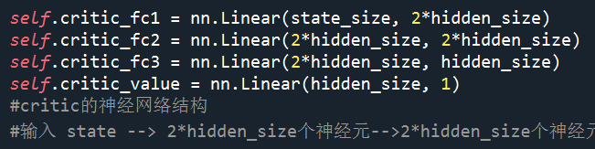
Algorithm：PPO (Critic net)
SOUTH CHINA UNIVERSITY OF TECHNOLOGY

Slide 19
Algorithm：PPO (Critic net)
SOUTH CHINA UNIVERSITY OF TECHNOLOGY
Value
State
Size:2*hidden_size

Slide 20
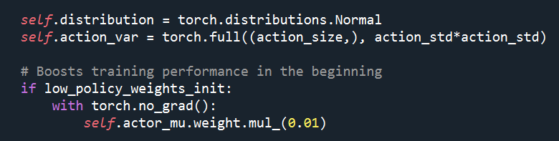
Algorithm：PPO (generate normal distribution)
SOUTH CHINA UNIVERSITY OF TECHNOLOGY

Slide 21
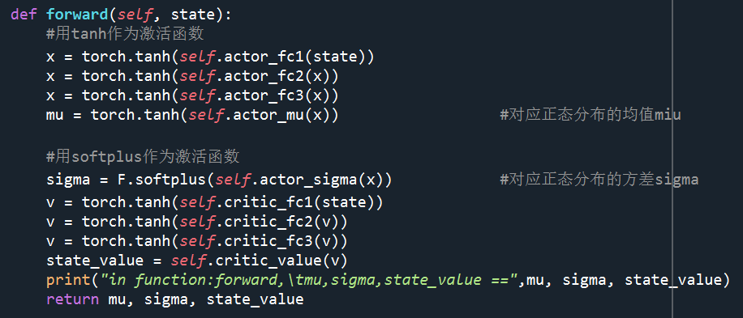
Algorithm：PPO (activate)
SOUTH CHINA UNIVERSITY OF TECHNOLOGY
activation function: tanh & softplus

Slide 22
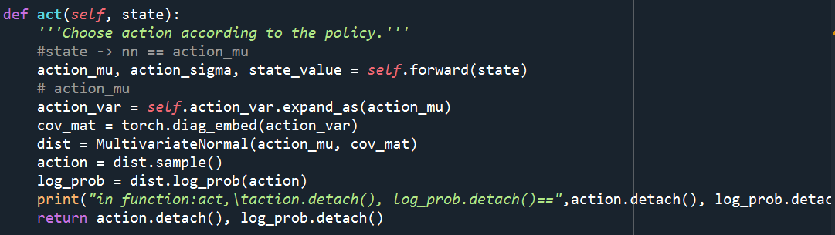
Algorithm：PPO (choose action)
SOUTH CHINA UNIVERSITY OF TECHNOLOGY

Slide 23
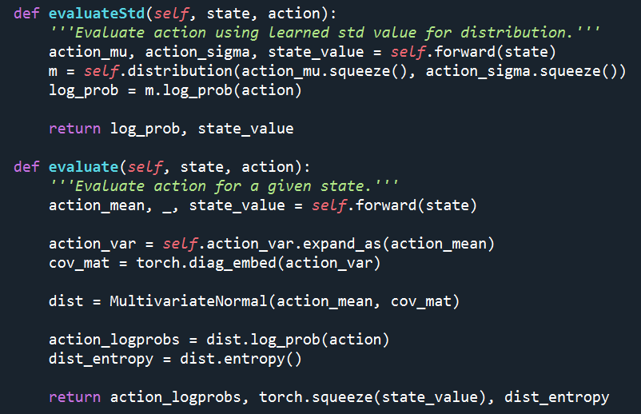
Algorithm：PPO (evaluate)
SOUTH CHINA UNIVERSITY OF TECHNOLOGY

Slide 24
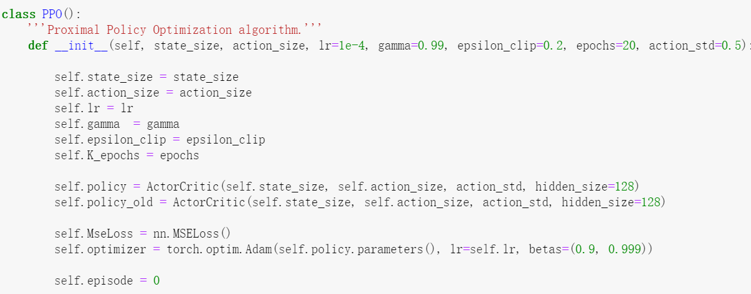
Algorithm：PPO
SOUTH CHINA UNIVERSITY OF TECHNOLOGY

Slide 25
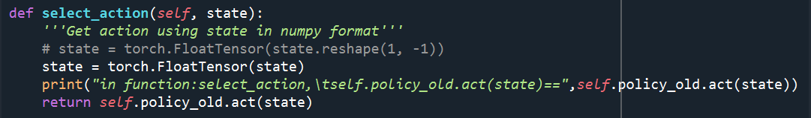
Algorithm：PPO（choose action）
SOUTH CHINA UNIVERSITY OF TECHNOLOGY

Slide 26
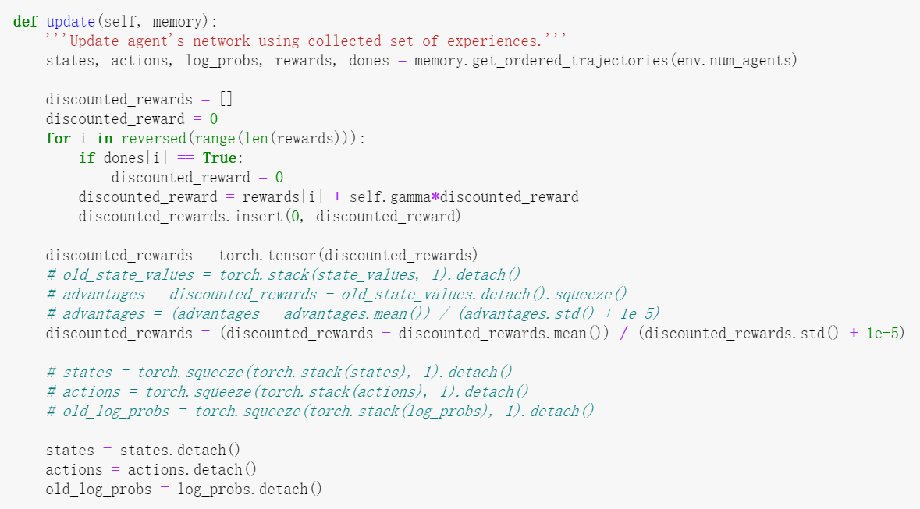
Algorithm：PPO (update)
SOUTH CHINA UNIVERSITY OF TECHNOLOGY

Slide 27
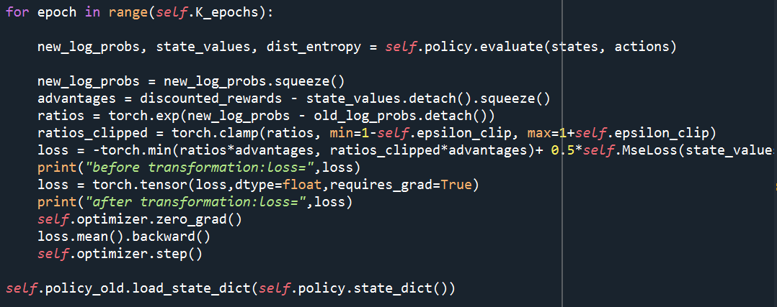
Algorithm：PPO (update)
SOUTH CHINA UNIVERSITY OF TECHNOLOGY

Slide 28
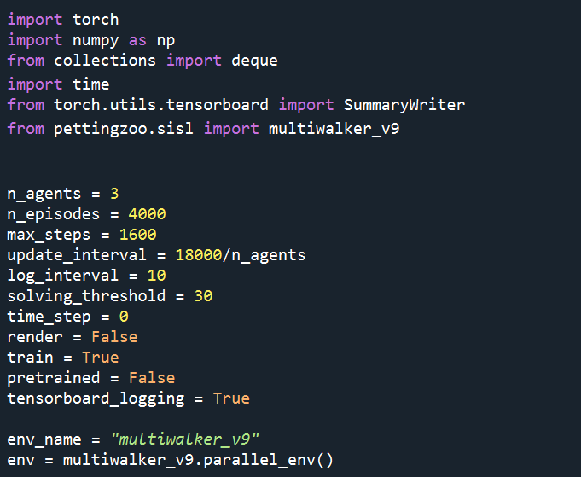
Train
SOUTH CHINA UNIVERSITY OF TECHNOLOGY

Slide 29
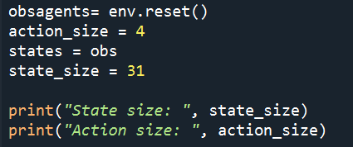
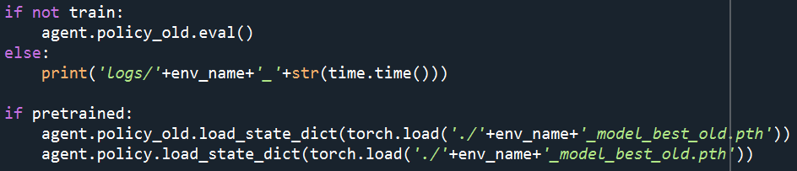
Train
SOUTH CHINA UNIVERSITY OF TECHNOLOGY
Output:
State size: 31
Action size: 4
logs/multiwalker_v9_1661221824.3281534

Slide 30
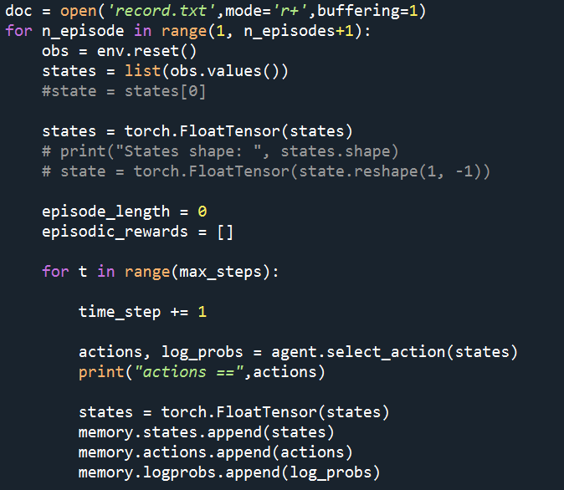
Train
SOUTH CHINA UNIVERSITY OF TECHNOLOGY

Slide 31
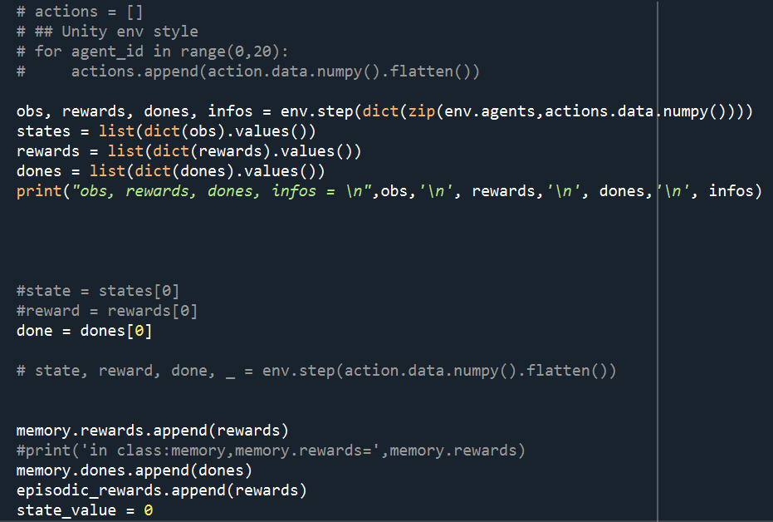
Train
SOUTH CHINA UNIVERSITY OF TECHNOLOGY

Slide 32
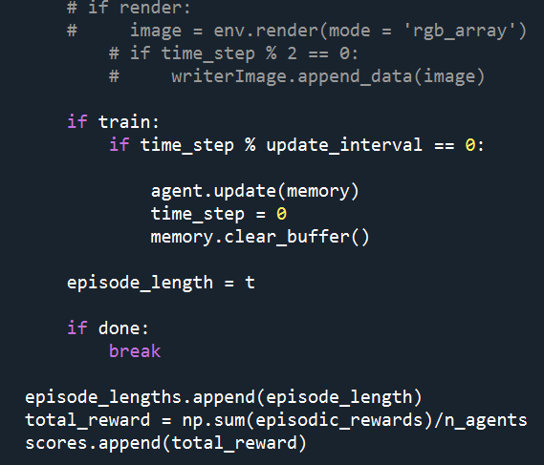
Train
SOUTH CHINA UNIVERSITY OF TECHNOLOGY

Slide 33
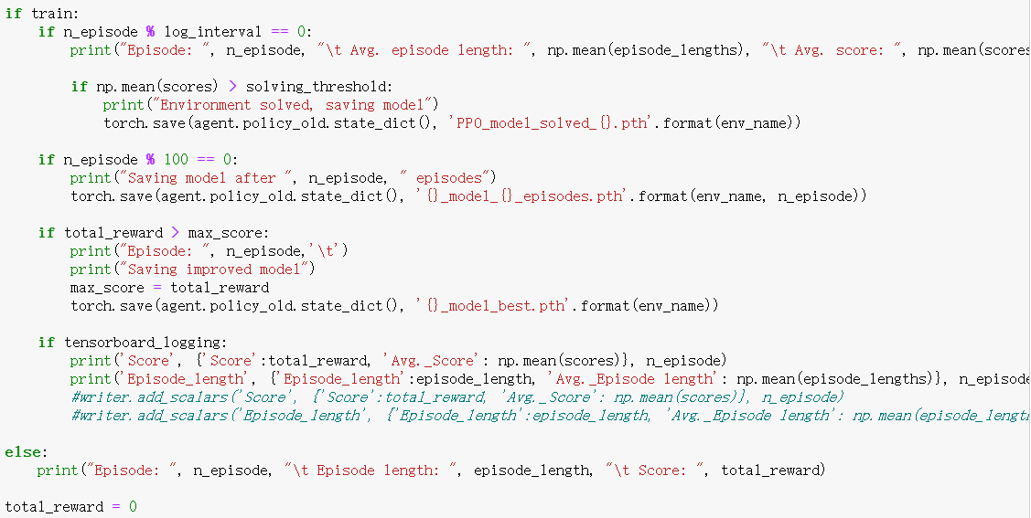
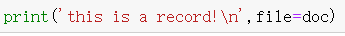
Train
SOUTH CHINA UNIVERSITY OF TECHNOLOGY

Slide 34
SOUTH CHINA UNIVERSITY OF TECHNOLOGY
03
Result

Slide 35
Training result
SOUTH CHINA UNIVERSITY OF TECHNOLOGY
Part of the results:
[WARNING]: Received an action [-0.01302117 -0.3006977 0.28979698 1.030534 ] that was outside action space Box(-1.0, 1.0, (4,), float32). Environment is clipping to space
[WARNING]: Received an action [ 0.8870487 -0.75611615 -1.3541977 0.623786 ] that was outside action space Box(-1.0, 1.0, (4,), float32). Environment is clipping to space
[WARNING]: Received an action [ 0.30768132 1.1568211 -0.12967755 -0.11784759] that was outside action space Box(-1.0, 1.0, (4,), float32). Environment is clipping to space
[WARNING]: Received an action [-1.0256941 -0.12364323 -0.35407615 0.16464111] that was outside action space Box(-1.0, 1.0, (4,), float32). Environment is clipping to space
[WARNING]: Received an action [0.05789854 0.21691133 0.22839119 1.1496832 ] that was outside action space Box(-1.0, 1.0, (4,), float32). Environment is clipping to space

Slide 36
SOUTH CHINA UNIVERSITY OF TECHNOLOGY
04
Undertake major programming tasks
Conclusion

Slide 37
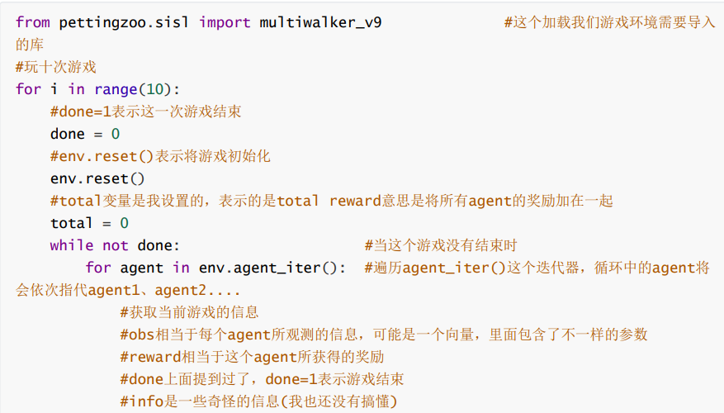
Iteration of project plans: version 1
SOUTH CHINA UNIVERSITY OF TECHNOLOGY
API interface
JUNE 12th

Slide 38
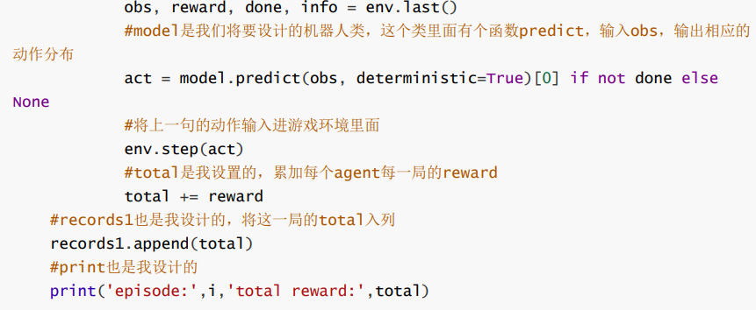
Iteration of project plans: version 1
SOUTH CHINA UNIVERSITY OF TECHNOLOGY
JUNE 12th

Slide 39
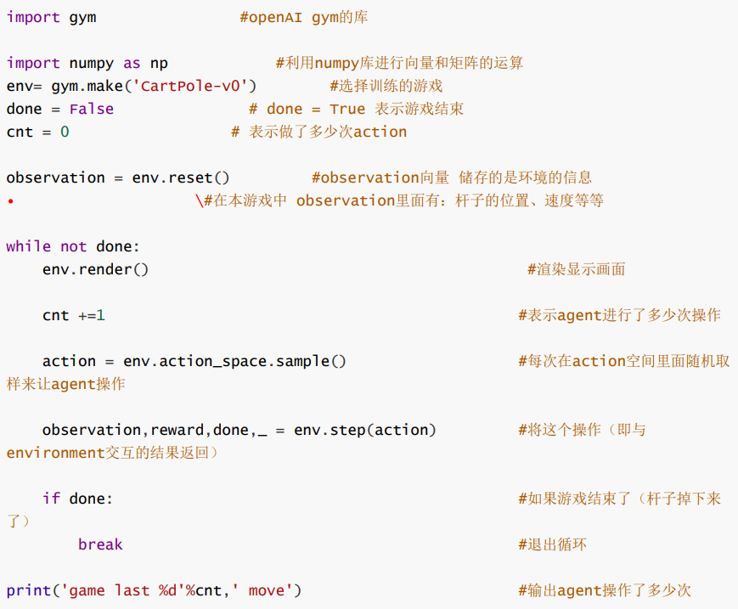
Iteration of project plans: version 2
SOUTH CHINA UNIVERSITY OF TECHNOLOGY
Single agent
JUNE 12th

Slide 40
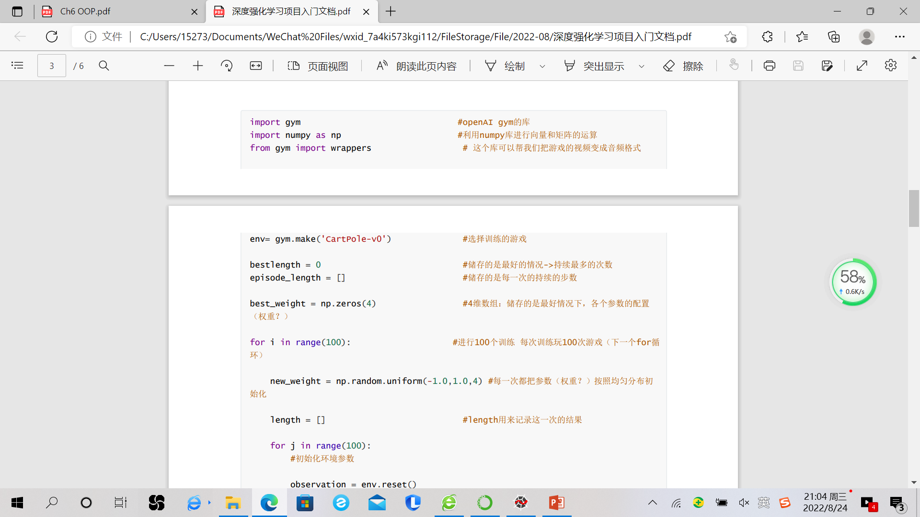
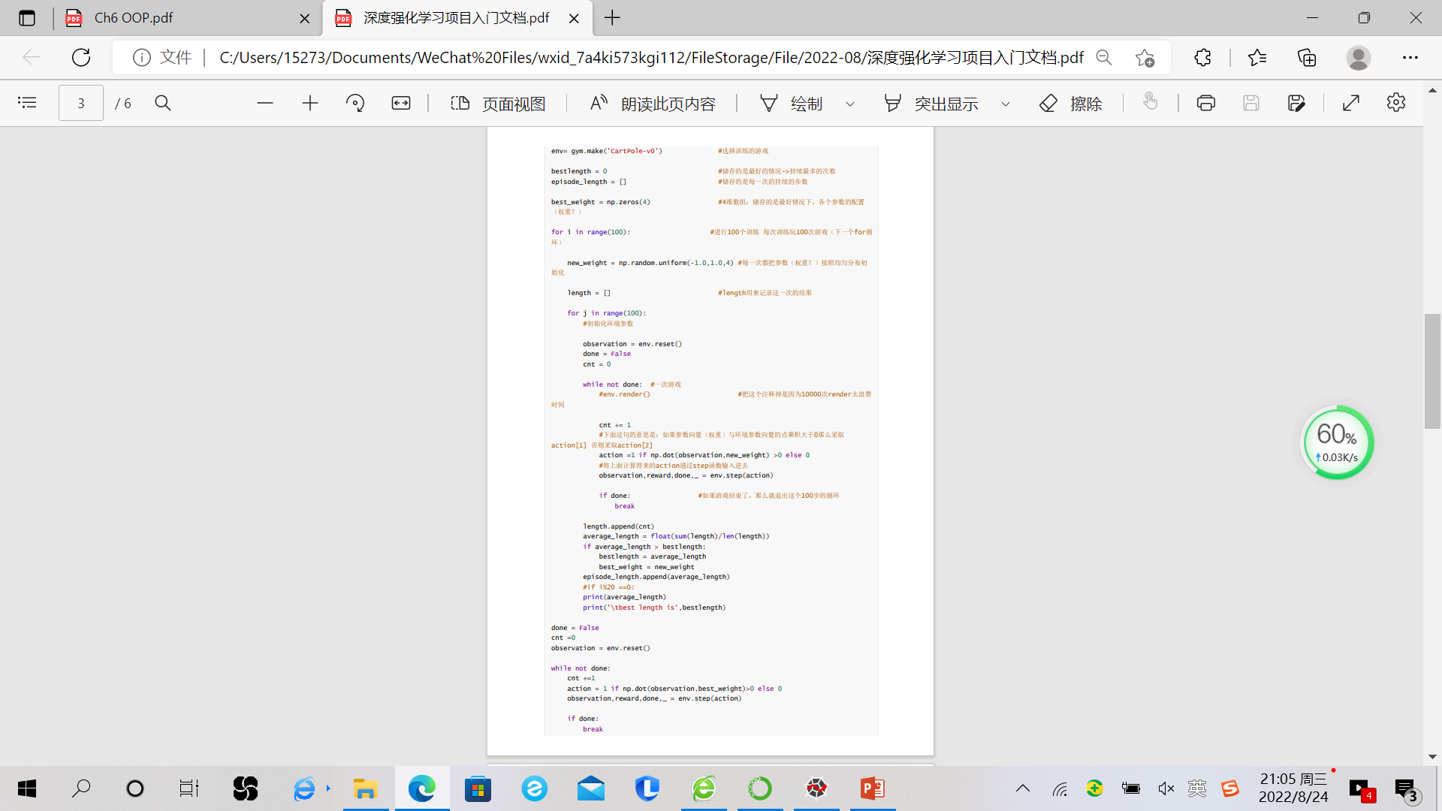
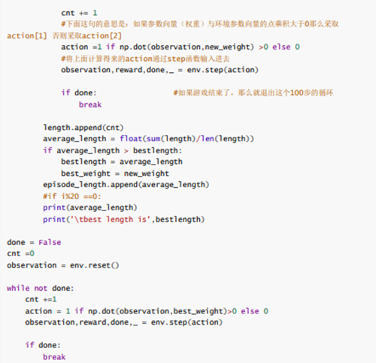
Iteration of project plans: version 2
SOUTH CHINA UNIVERSITY OF TECHNOLOGY
JUNE 12th

Slide 41
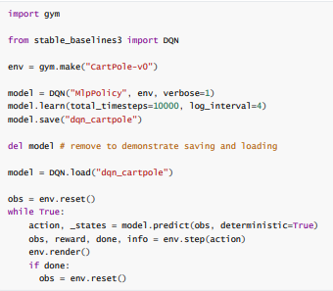
Iteration of project plans: version 3
SOUTH CHINA UNIVERSITY OF TECHNOLOGY
Algorithm: DQN
JUNE 12th

Slide 42
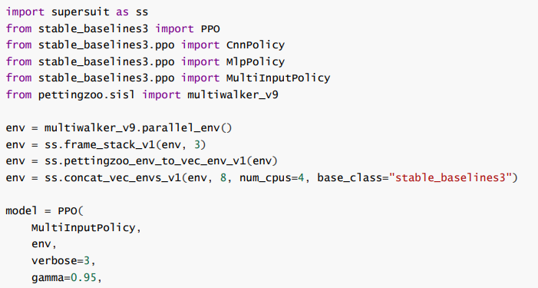
Iteration of project plans: version 4
SOUTH CHINA UNIVERSITY OF TECHNOLOGY
Three agents
Encapsulate algorithms (PPO) using stable_baselines 3
JUNE 12th

Slide 43
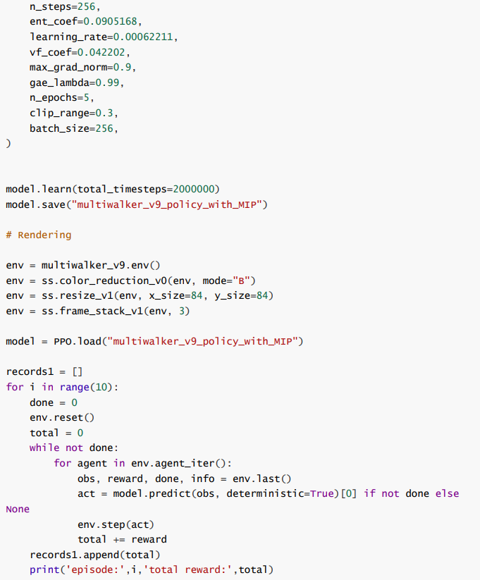
Iteration of project plans: version 4
SOUTH CHINA UNIVERSITY OF TECHNOLOGY
JUNE 12th

Slide 44
Division of labor
SOUTH CHINA UNIVERSITY OF TECHNOLOGY
Group Name: Polaris
Group Members:
Yongjie Liang (Ragan): Environment & Algorithm selection and code implementation, documentation
Weiyue Zhang: Configuration of the code environment and finding code examples
Jieyi Sun (Team leader): Task assignment and group management
Ruoqi Chen: Algorithm material, data search, PPT production, assisting in code implementation
Yuxuan Chen: Assist with running routines, finding games, searching information
Yihao Shen: Data processing and visualization(pandas, matplotlib)
JUNE 12th

Slide 45
SOUTH CHINA UNIVERSITY OF TECHNOLOGY
Thanks for listening！
24th Aug, 2022
汇报人：小邱小邱
指导老师：大邱大邱

